Slide 1
Attention Is All You Need

Slide 2
Introduction
Recurrent neural networks (RNNs), Long ShortTerm Memory (LSTM), and Gated Recurrent Networks (GRNs) are leading approaches in sequence modeling and transduction problems like language modeling and machine translation
These techniques have proven to be stateoftheart in a variety of domains, pushing boundaries in areas like language models and encoderdecoder architectures.

Slide 3
Literature Review
Recent work achieving significant improvements in computational efficiency through factorization tricks and conditional computation
Improved model performance, especially in case of the latter
Attention mechanisms playing a crucial role in compelling sequence modeling and transduction models
Modeling of dependencies without regard to their distance in input or output sequences
Attention mechanisms typically used in conjunction with recurrent networks

Slide 4
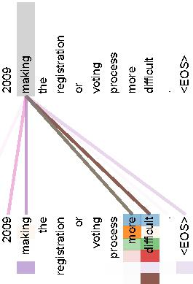
Literature Review

Slide 5
Methodology
Decoder is made up of N identical layers, each consisting of two sublayers: multihead selfattention mechanism and fully connected feedforward network.
The output is obtained through the formula LayerNorm(x + Sublayer(x)), where Sublayer(x) is the function implemented by the sublayer itself.
All sublayers in the model and embedding layers produce outputs of dimension dmodel = 512 to enable residual connections.
The encoder introduces a third layer that performs multiattention over the output of the encoder stack to prevent positions from attending to subsequent positions.
The decoder architecture is designed to facilitate information flow and learning through the sequential layers effectively.

Slide 6
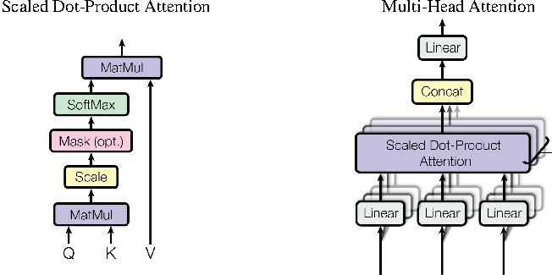
Methodology

Slide 7
Results
Study presents two examples from two different heads from encoder selfattention at layer 6
Heads clearly learned to perform different tasks

Slide 8
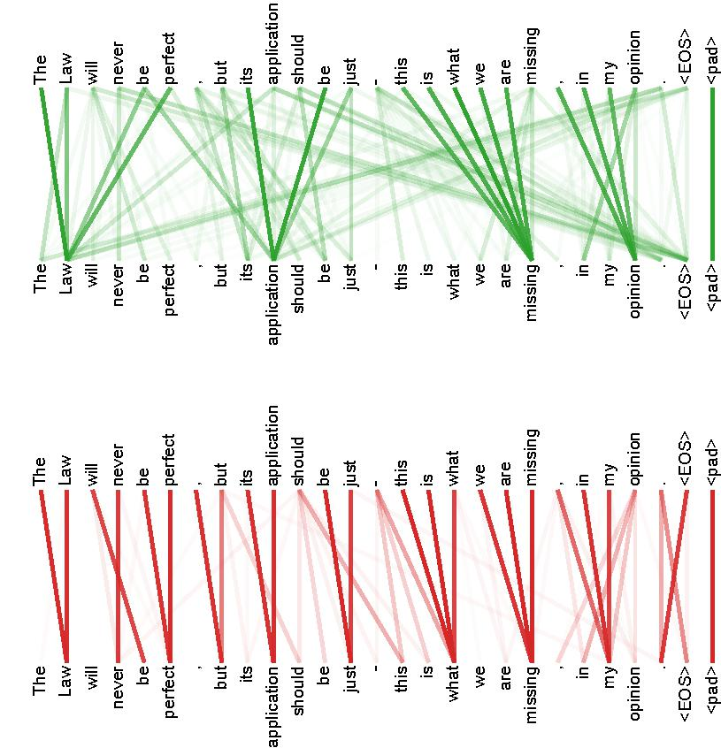
Results

Slide 9
Conclusion
Achieved 28.4 BLEU on WMT 2014 EnglishtoGerman translation task
Attained a new singlemodel stateoftheart score of 41.8
Trained for 3.5 days on eight GPUs
Significantly lower training costs compared to best models in literature
Successfully applied Transformer to English constituency parsing with both large and limited training data

